Slide 1
Chapter 6
Cytoplasmic Signaling Circuitry Programs Many of the Traits of Cancer
Nov 1, 2023
Notes:
信号转导非常复杂，延续上次课内容，进一步探讨影响肿瘤的信号通路

Slide 2
Outline of today`s lecture
1, Receptor tyrosine kinase(RTK) and Ras signaling.
1a, RTK-Ras signaling mechanism;
1b, Ras downstream signaling: MAPK; PI3K; Ral;
2, Other type of cytoplasmic signaling.
2a, Jak-STAT; Wnt; GPCR; Integrin;
2b, Other “Dual address ” signaling: NF-κB; Notch; Hedgehog; TGF-β
Notes:
最核心的oncogene信号通路 RTK-Ras通路

Slide 3
Cell signaling
As much as 30% of the volume of the cell is taken up by proteins rather than aqueous solvent.
Signaling specificity
Signaling efficiency
Notes:
细胞内部结构精密复杂，各种蛋白，各种结构 细胞内有序排列，有屋顶（细胞膜），支架（细胞骨架），各类小房间，交通运输，中央控制机构。。。

Slide 4
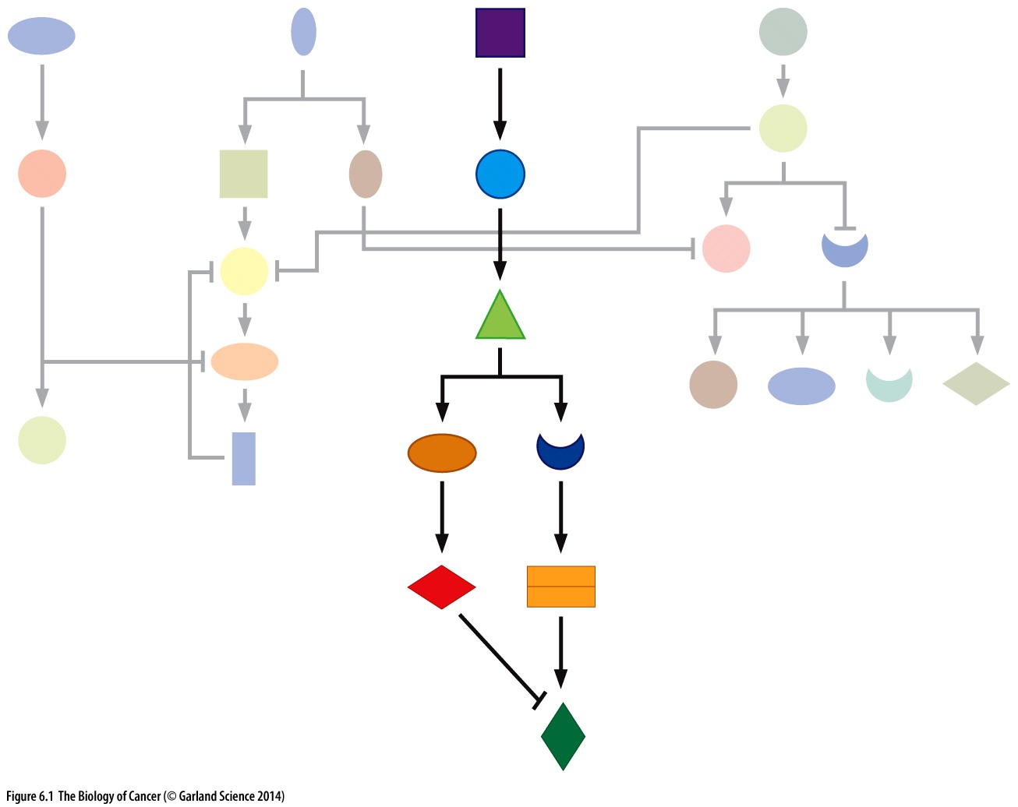
Figure 6.1 Signaling cascades
This diagram of imaginary signaling circuitry illustrates how a signal transduction cascade—a series of signaling proteins that operates much like a molecular bucket（水桶） brigade(队列)—passes signals from an upstream source to its intended downstream target and, at the same time, avoids inadvertent activation of dozens of other signaling proteins in the cell.
Notes:
Arrowheads denote a stimulatory signal, while a line at right angles (a crossbar) denotes an inhibitory signal.

Slide 5
Immediate vs. delayed early genes
Within less than half hour, transcription of an ensemble of more than 100 cellular genes was induced (Figure 6.2). These genes (including MYC) were called immediate early genes.
The levels of MYC mRNA were found to rise steeply following mitogen addition and to collapse quickly following mitogen removal. Moreover, the MYC protein itself turns over rapidly, having a half-life of only 25 minutes.

Slide 6
Immediate vs. delayed early genes
Within an hour after the immediate early mRNAs appear, a second wave of gene induction was found to occur. Significantly, the induction of these delayed early genes was largely blocked by the presence of cycloheximide (放线菌酮), indicating that their expression did indeed depend on de novo protein synthesis (Figure 6.3).

Slide 7
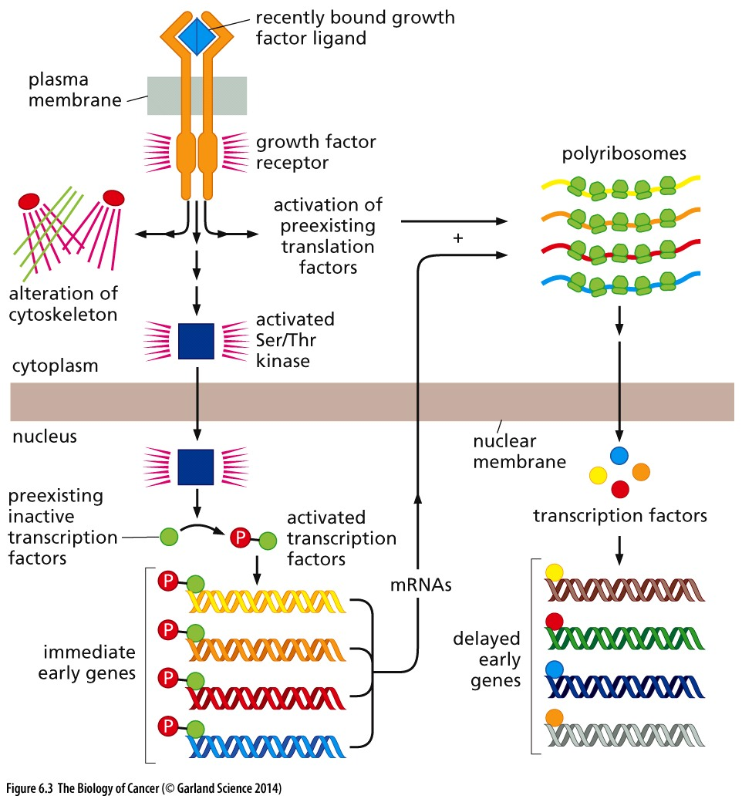
Figure 6.3 Immediate vs. delayed early genes

Slide 8
6.2 The Ras protein stands in the middle of a complex signaling cascade
Notes:
Ras 和 RTK 在一个信号通路， 这是怎样被发现的……

Slide 9
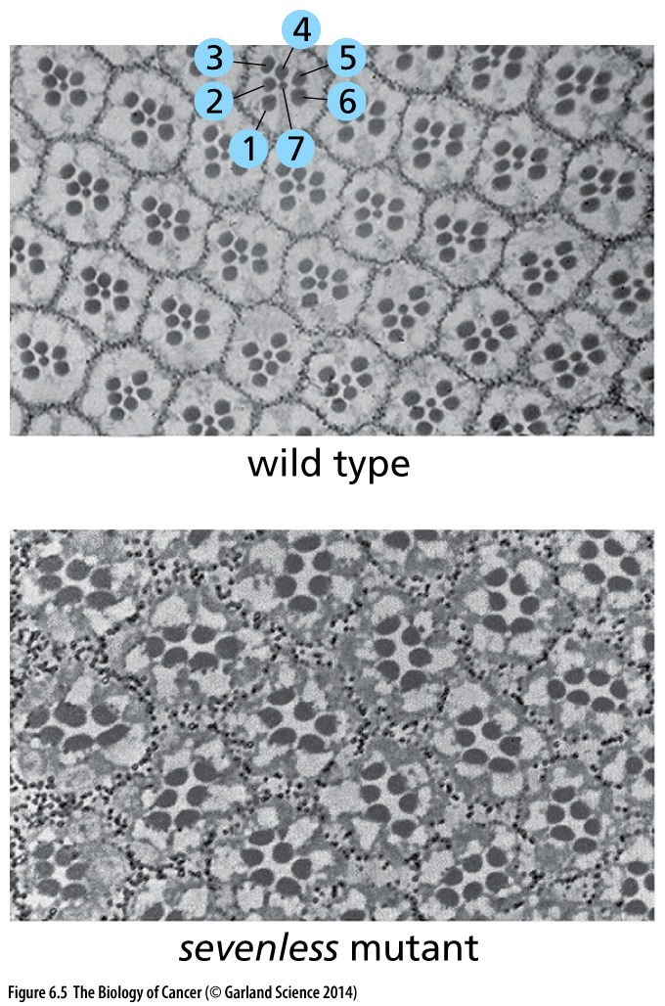
Figure 6.5 Structure of the fly eye
Study of the light-sensing units in the Drosophila melanogaster eye—the ommatidia(小眼)—revealed that each ommatidium is normally formed from a series of seven cells, with six outer ones surrounding a seventh in the center, as seen in this electron micrograph section (upper panel). A fly carrying the mutation in the gene that came to be called sevenless produced ommatidia lacking the seventh, central cell (lower panel). Later, sevenless was found to encode a homolog of the mammalian fibroblast growth factor (FGF) receptor.

Slide 10
Genetic complementation experiments
Sevenless
X
Sevenless mutation
X
Sevenless
Loss of 7th cell
7th cell formation
7th cell formation
X mutation
Sevenless activation + X mutation → loss of 7th cell
Sevenless activation + X mutation → formation of 7th cell
Notes:
如何决定信号通路上下游次序？

Slide 11
Son of sevenless(SOS)
Yet other mutations mimicked the effects of Sevenless mutation. Genetic complementation tests revealed that these mutations affected genes whose products operate downstream of Sevenless. One of these downstream proteins was encoded by a gene that was named Son of sevenless or simply Sos. Close examination of the Sos protein showed it to be related to proteins known from yeast biochemistry to be involved in provoking nucleotide exchange by G proteins such as Ras. The yeast proteins, often called guanine nucleotide exchange factors (GEFs), were known to induce G-proteins to release their bound GDPs. The consequence was an activation of these G-proteins from their inactive to their active, signal-emitting configuration. This was precisely the effect that Sos exerted on Ras proteins (Figure 6.6). Therefore, Sos appeared to be the long-sought upstream stimulator that kicked Ras into its active configuration.

Slide 12
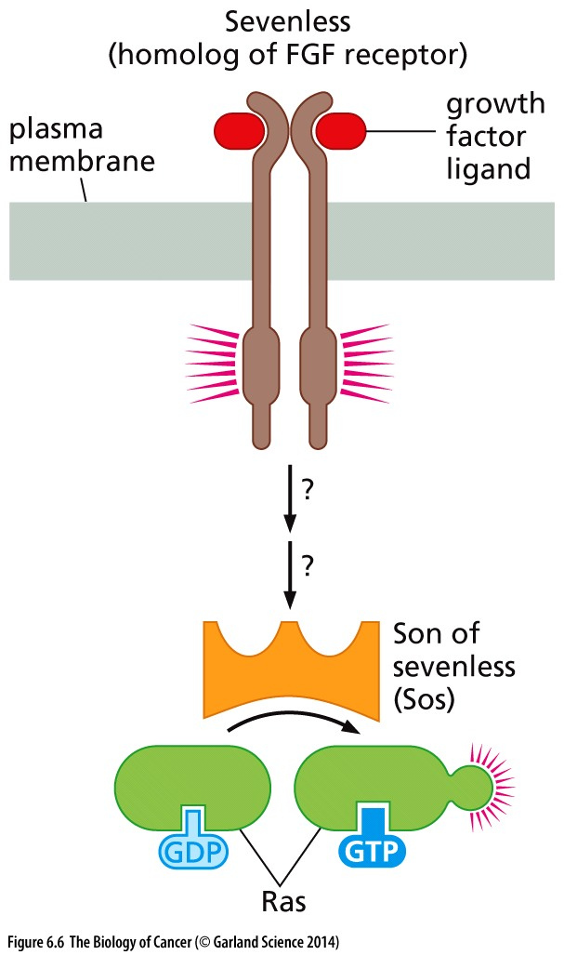
Figure 6.6 Son of sevenless
Genetic studies of Drosophila eye development revealed another gene whose product appeared to lie downstream of Sevenless (see Figure 6.5) in a signaling cascade and specified a guanine nucleotide exchange factor (GEF), capable of activating the Ras protein. This gene was named Son of sevenless or simply Sos.

Slide 13
Receptor tyrosine kinase signaling pathway
Together, the genetic and biochemical data from these distantly related animal phyla could be combined in a scheme that suggested a linear signaling cascade organized like this: tyrosine kinase receptor → Shc → Grb → Sos → Ras.

Slide 14
6.3 Tyrosine phosphorylation controls the location and thereby the actions of many cytoplasmic signaling proteins

Slide 15
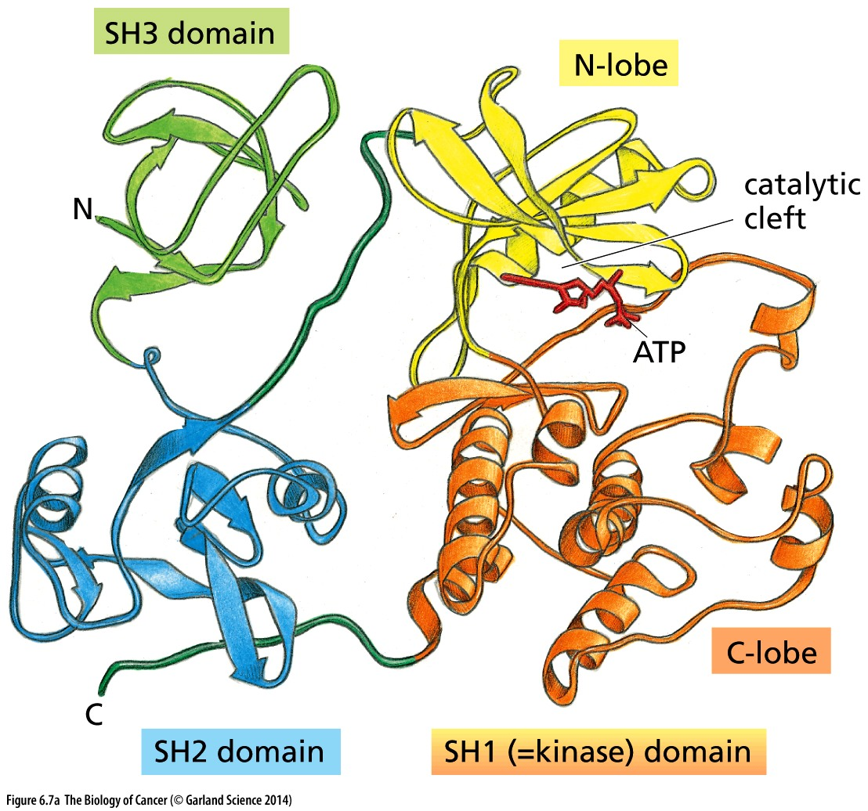
Figure 6.7 Domain structure of the Src protein
Shown is the ribbon diagram of Src. Like many other subsequently analyzed protein kinases, the catalytic Src homology domains 1(SH1) domain is seen to be composed of two subdomains , termed the N- and C-lobes of the kinase. Between these lobes is the ATP-binding site where catalysis takes place (red stick figure). The SH2 and SH3 domains are involved in substrate recognition and regulation of catalytic activity.
Notes:
Src是研究tyrosine kinase的祖宗，许多结构域都是以src同源命名的，如：Src homology domains 1, 2, and 3 (SH1, SH2, and SH3)

Slide 16
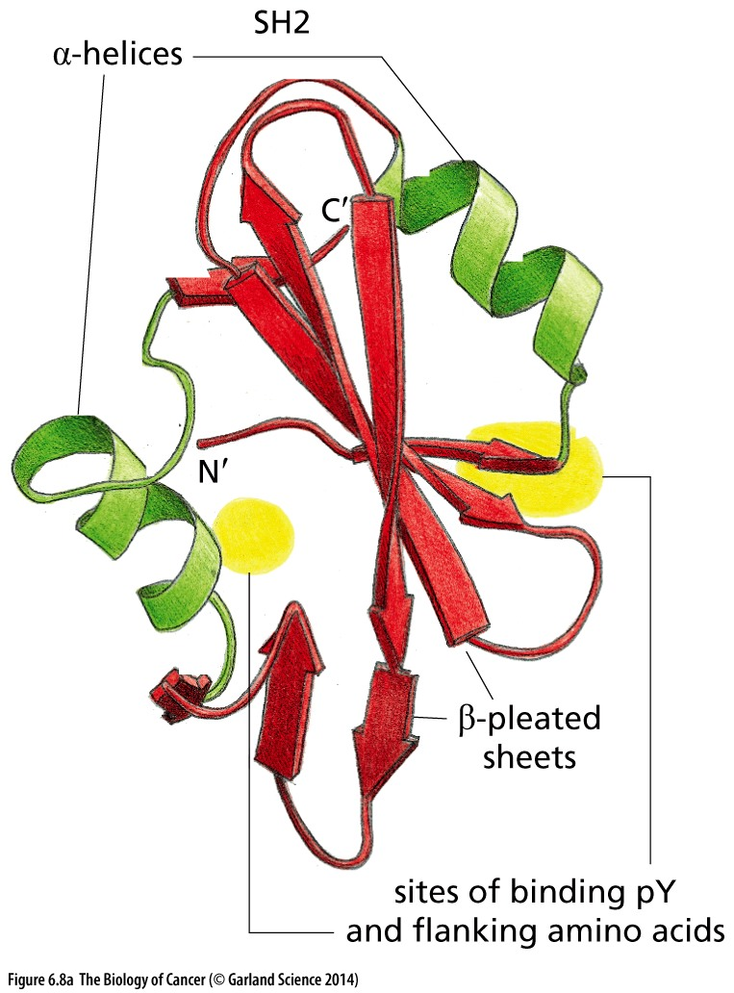
Figure 6.8 Structure and function of SH2 and SH3 domains
a typical SH2 domain is composed of about 100 amino acid residues and is assembled from a pair of anti-parallel β-pleated sheets (red) surrounded by a pair of α-helices (green). The sites of interaction by the SH2 domain with its “ligand”—a phosphotyrosine (pY)- containing peptide.
SH2 bind phosphotyrosine

Slide 17
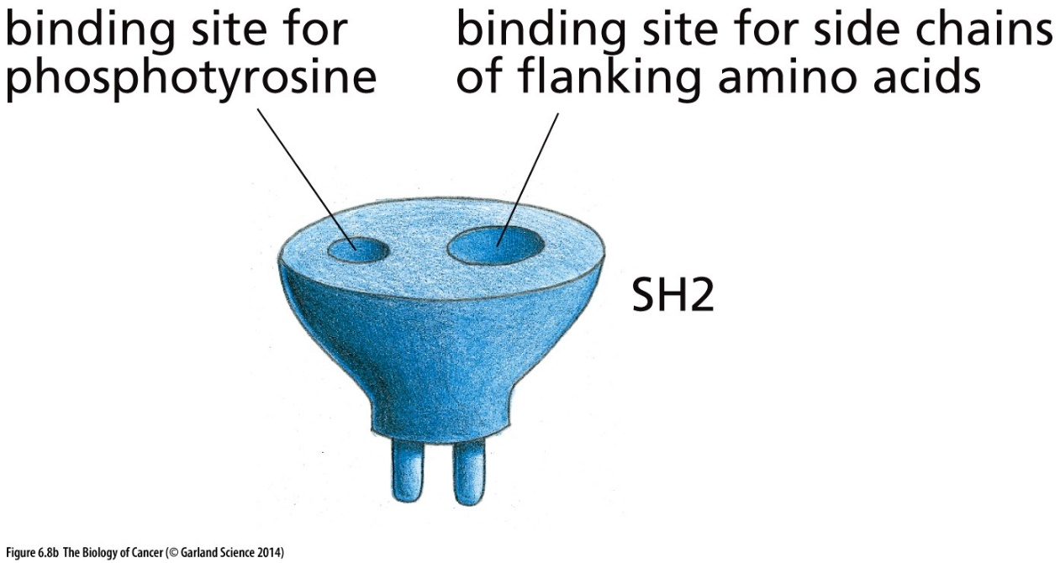
Figure 6.8 Structure and function of SH2 and SH3 domains
As indicated, the SH2 domain can be thought to function like a modular plug: it recognizes both a phosphotyrosine and the amino acids that flank this phosphotyrosine on its C-terminal side.

Slide 18
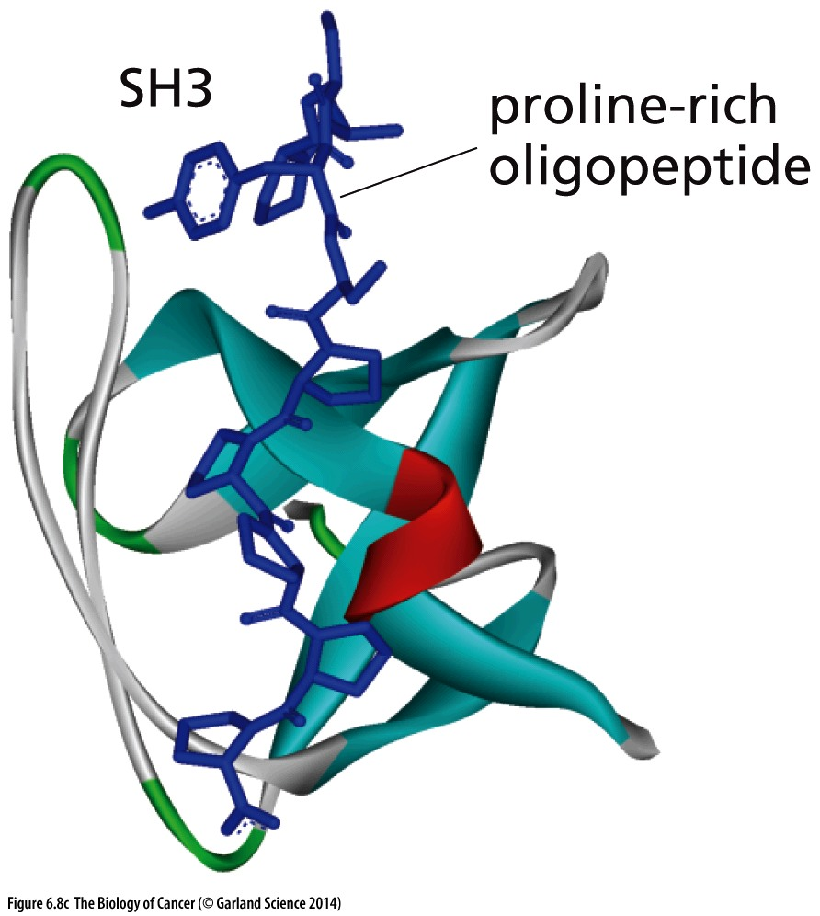
Figure 6.8 Structure and function of SH2 and SH3 domains
The SH3 domain (ribbon diagram), also shown in a different orientation from that of Figure 6.7, recognizes as its ligands proline-rich oligopeptide (blue stick figure) sequences in partner proteins.
SH3 bind proline-rich peptide

Slide 19
SH2 domain bind phosphotyrosine
The discoveries about SH2 groups finally solved the puzzle of how tyrosine kinase receptors are able to emit signals. The story is illustrated schematically in Figure 6.9.

Slide 20
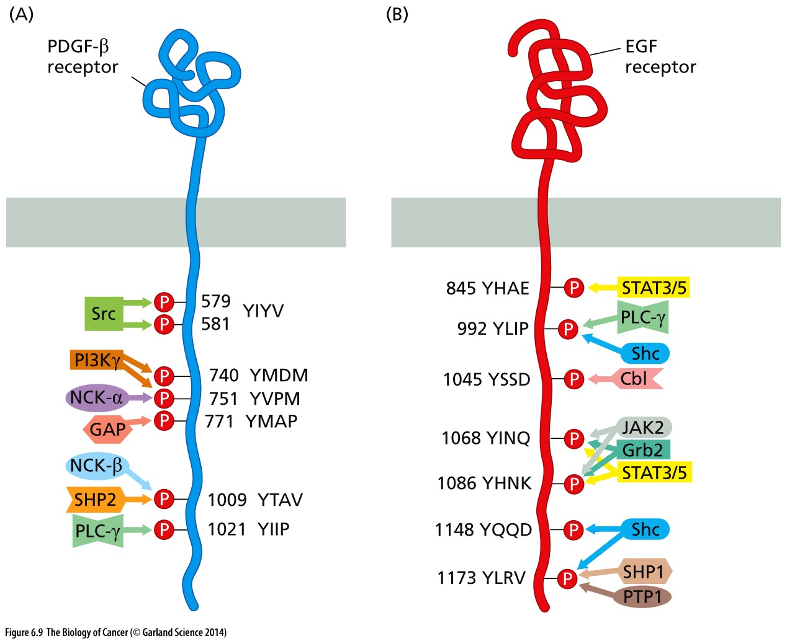
Figure 6.9 Attraction of signal transducing proteins by phosphorylated receptors

Slide 21
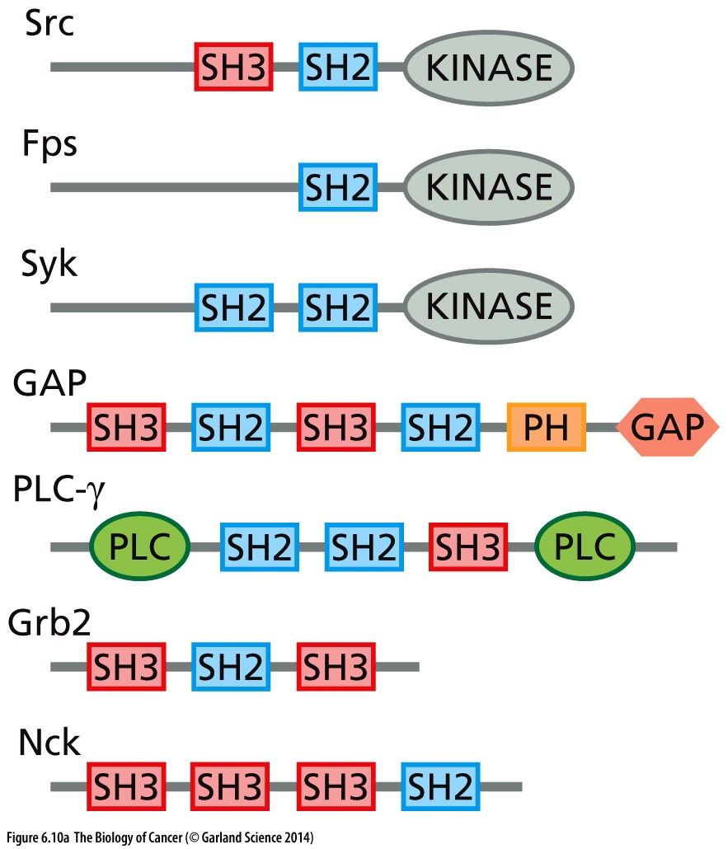
Figure 6.10 Protein interaction domains as modular units of protein structure
Specific multiprotein complexes are formed using domains such as the SH2, SH3, and PH domains, which bind phosphotyrosines, proline-rich sequences, and PIP3, respectively. At the bottom are shown two adaptor or “bridging” proteins that contain only SH2 and SH3 domains and lack catalytic domains; each of these adaptors serves as a linker between pairs of other proteins, one of which carries a certain phosphotyrosine (to which an SH2 domain can bind) and the other of which carries a proline-rich domain (to which an SH3 domain can bind; see Figure 6.12).

Slide 22
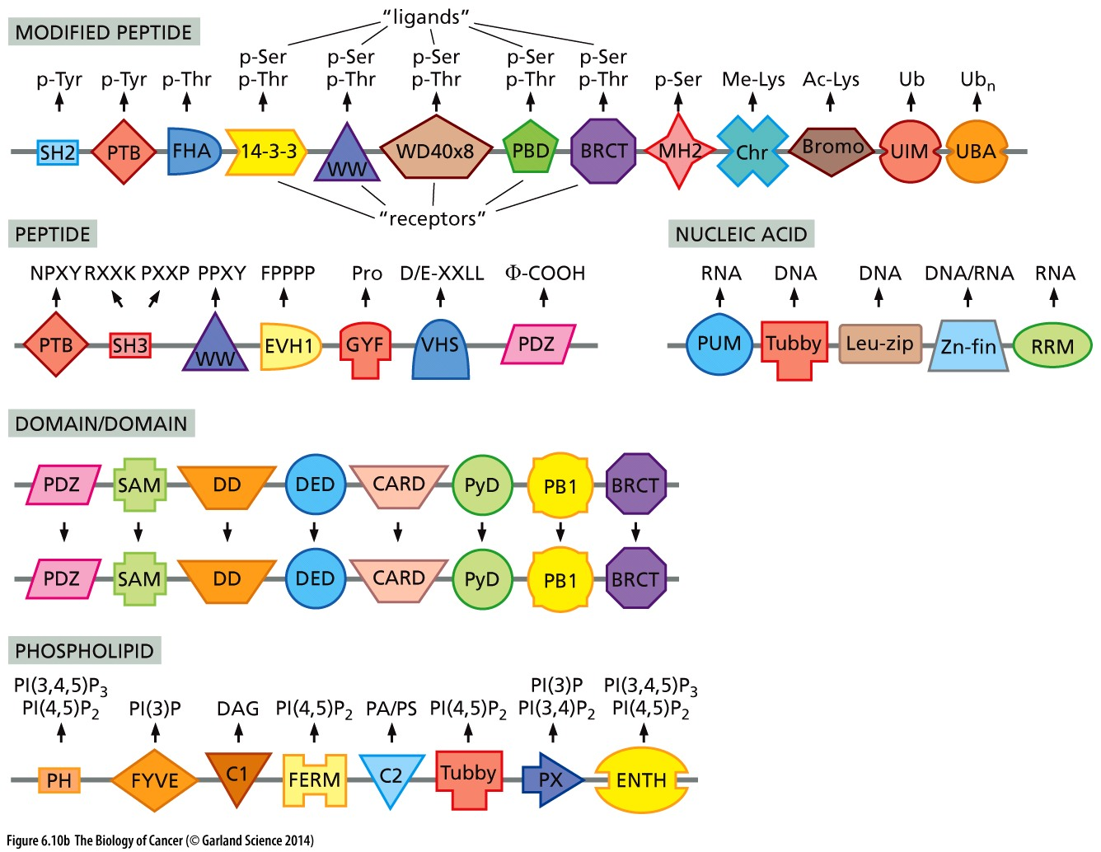
As shown, a variety of modified amino acid residues, peptide sequences, nucleic acids, and phospholipids can serve as ligands of the indicated domains. In addition, certain domains (“domain/domain”) favor the homodimerization of two protein molecules.
Notes:
非常复杂，仅供参考

Slide 23
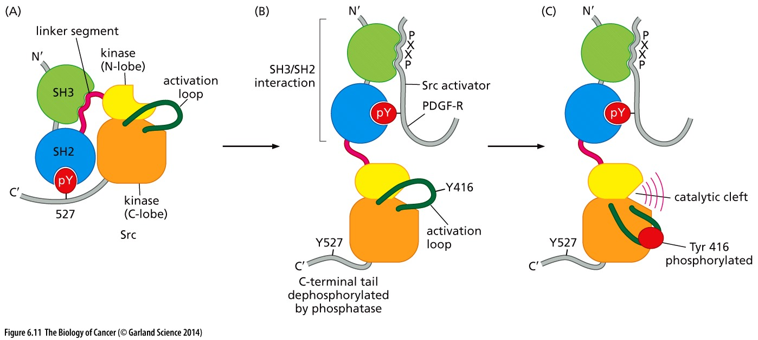
Figure 6.11 Structure and function of Src
(A) Inactive Src; (B) ready to active Src; (C) fully active Src.
Notes:
可见：1，Src如何被调控； 2， Src如何参与RTK 信号通路； 非常经典！

Slide 24
Oncogene src and proto-oncogene SRC
The Src oncoprotein specified by Rous sarcoma virus is a mutant form of the normal c-Src protein, in which the C-terminal oligopeptide domain containing the tyrosine 527 residue has been replaced by another, unrelated amino acid sequence.

Slide 25
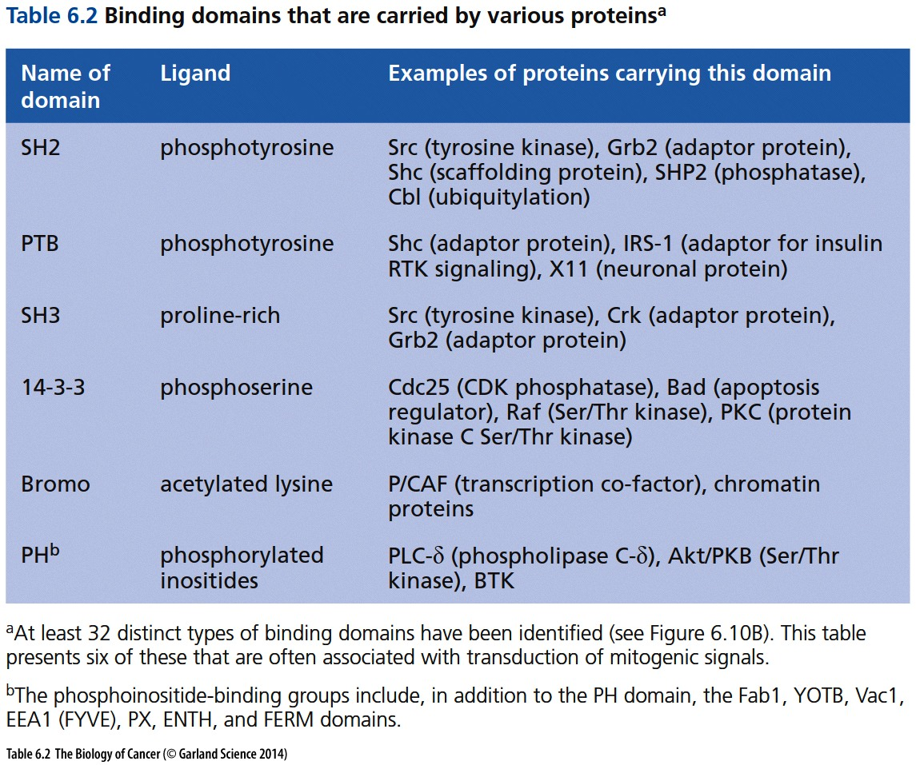

Slide 26
6.4 SH2 and SH3 groups explain how growth factor receptors activate Ras and acquire signaling specificity

Slide 27
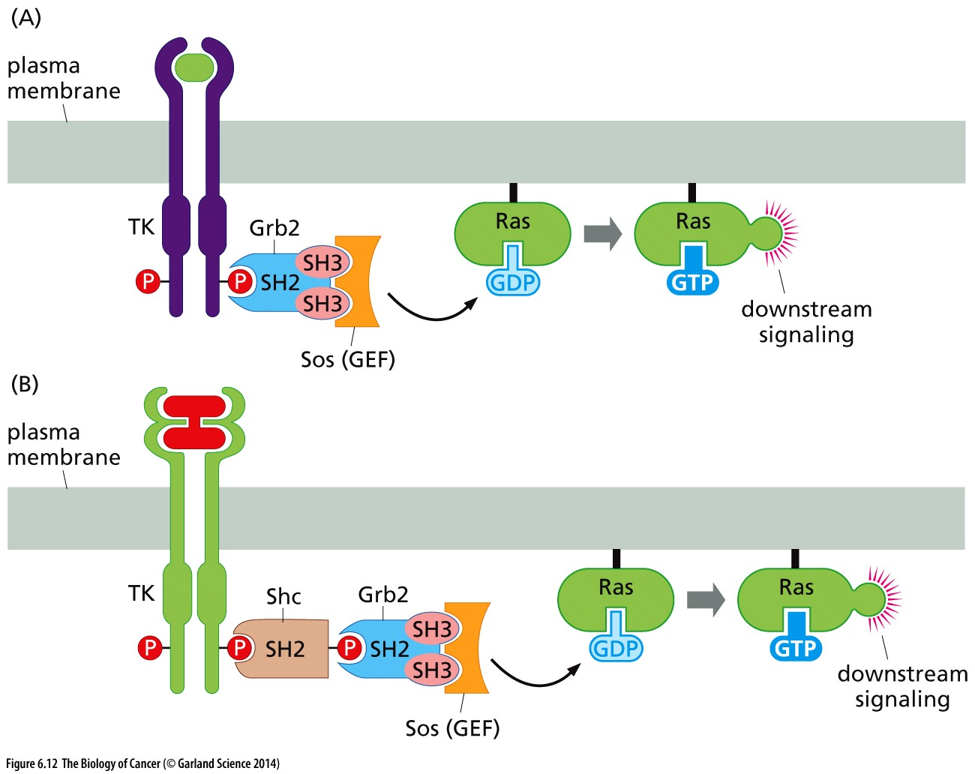
Figure 6.12 Intermolecular links forged by the Grb2 and Shc bridging proteins
(A) The association of Sos, the Ras guanine nucleotide exchange factor (GEF), with ligand-activated growth factor receptors is achieved by bridging proteins, such as Grb2 shown here. (B) An alternative mode of association can be achieved through a collaboration between two bridging proteins, Grb2 and Shc.

Slide 28
6.5 Ras-regulated signaling pathways: A cascade of kinases forms one of three important signaling pathways downstream of Ras

Slide 29
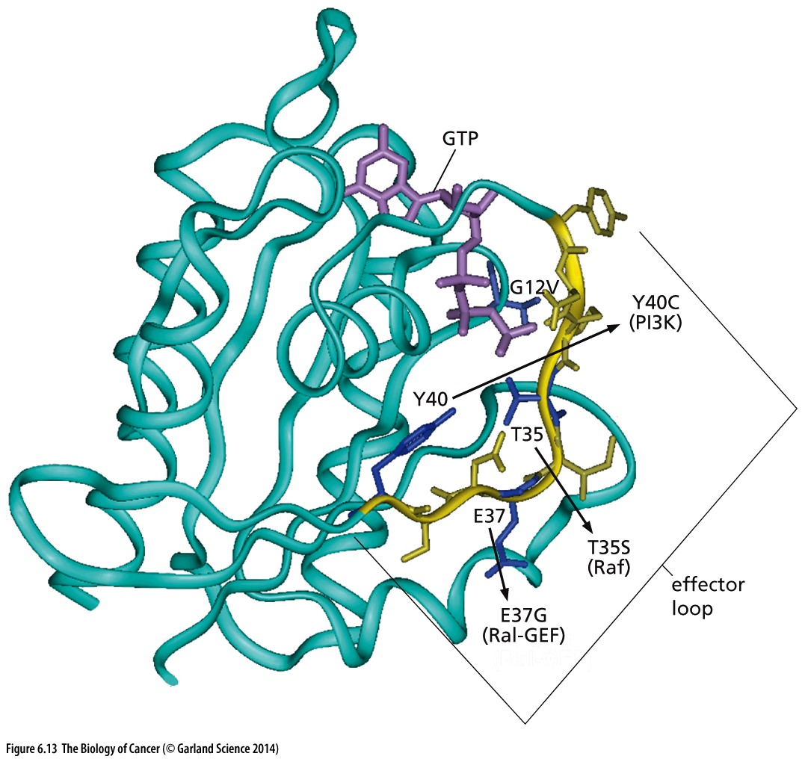
Figure 6.13 The Ras effector loop
The crystallographic structure of the Ras protein is depicted here. The guanine nucleotide (purple stick figure) is shown together with the nearby glycine residue, which, upon replacement by a valine, causes inactivation of the GTPase activity (G12V). The effector loop (yellow) interacts with at least three important downstream effectors of Ras. Amino acid substitutions (arrows) affecting three residues in the effector loop create three alternative forms of the Ras protein that interact preferentially with either PI3 kinase, Raf, or Ral-GEF.

Slide 30
1st Ras effector: Raf and MAPK pathway
The first of these Ras effectors to be discovered was the Raf kinase (Figure 6.14). Raf phosphorylates substrate proteins on their serine and threonine residues. Long before its association with Ras was uncovered, the Raf kinase had already been encountered as the oncoprotein specified by both a rapidly transforming murine retrovirus and, in homologous form, a chicken retrovirus (see Table 3.3).
This type of kinase signaling cascade has been given the generic name of a MAPK (mitogen-activated protein kinase) pathway.
Notes:
MAPK pathway 研究的比较早，实际上该通路在肿瘤中的变异往往比不上后面提到的PI3K 通路，该通路广义上与细胞应急反应相关。值得注意的是B-RAF在melanoma中的变异。

Slide 31
Mitogen-activated protein kinase (MAPK)
Mitogen is grow factor that stimulate cell division, like PDGF
The first identified MAPK was ERK1 in mammals. Since ERK1 is involved in growth factor signaling, the family was termed "mitogen-activated". With the discovery of other members, even from distant organisms (e.g. plants), it has become increasingly clear that the name is a misnomer, since most MAPKs are actually involved in the response to potentially harmful, abiotic stress stimuli (hyperosmosis, oxidative stress, DNA damage, low osmolarity, infection, etc.). Because plants cannot "flee" from stress, terrestrial plants have the highest number of MAPK genes per organism ever found.

Slide 32
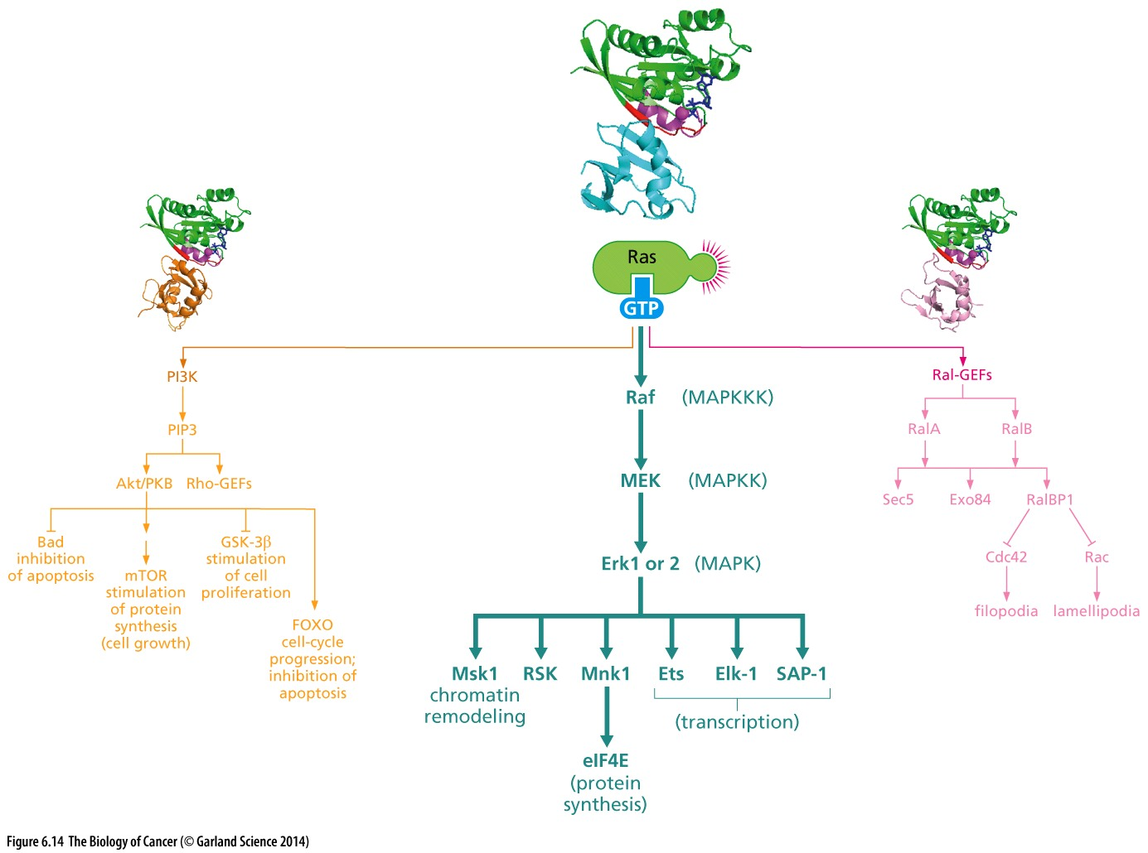
Figure 6.14 The Ras → Raf → MAP kinase pathway
Phosphate groups attached to MEK by Raf cause a shift in its structure that results in its functional activation as a kinase.

Slide 33
6.6 Ras-regulated signaling pathways: a second downstream pathway controls inositol lipids and the Akt/PKB kinase

Slide 34
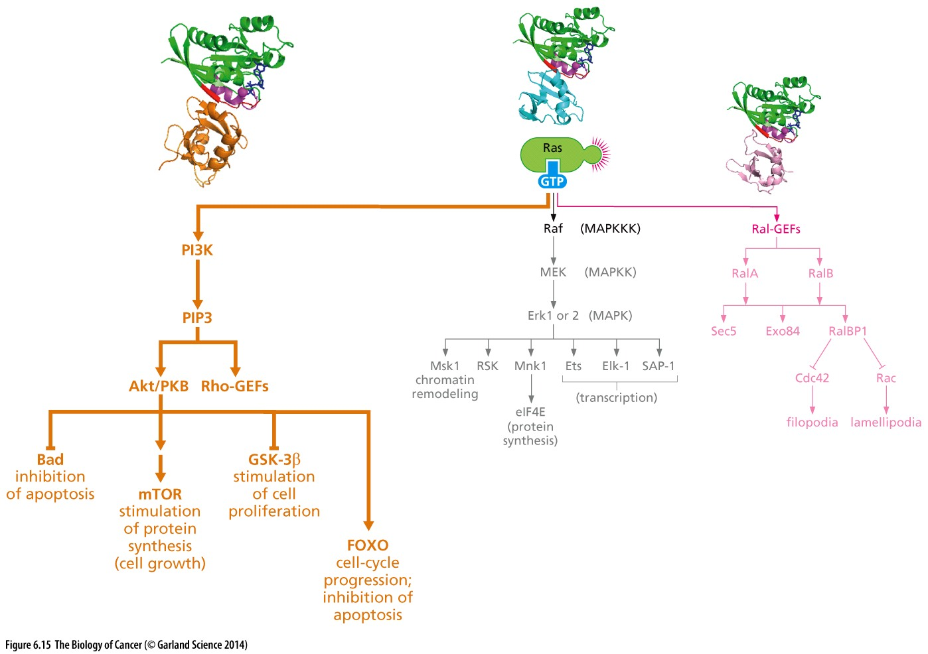
Figure 6.15 The PI3 kinase pathway
Essential component of PI3K pathway:
PI3K, AKT, PTEN, mTOR
Notes:
PI3K pathway是最重要oncogenic pathway !

Slide 35
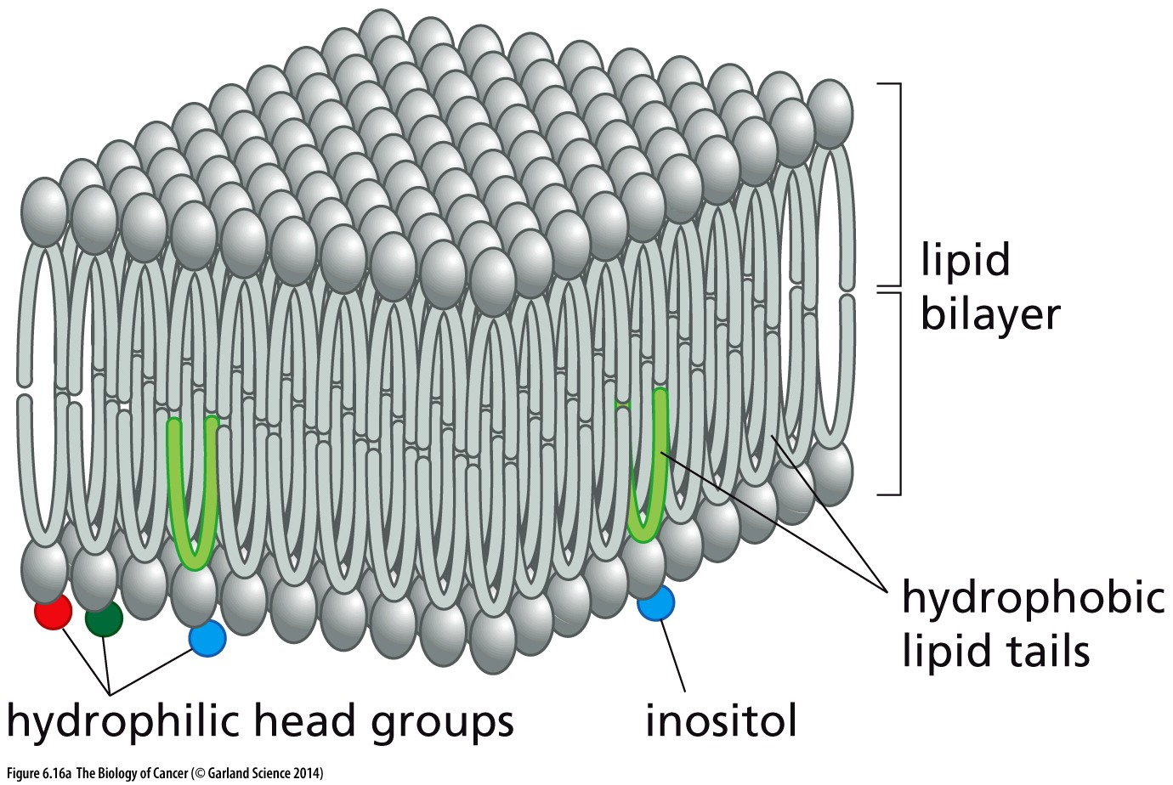
Figure 6.16 Biochemistry of lipid bilayers
The lipid bilayer is very thin. If a typical mammalian cell (diameter ~10 micrometers) were magnified to the size of a watermelon (~30 cm), the lipid bilayer (7-10nm) would be about as thick as a piece of office paper.
肌醇
Notes:
前面提到细胞内部结构精密复杂，

Slide 36
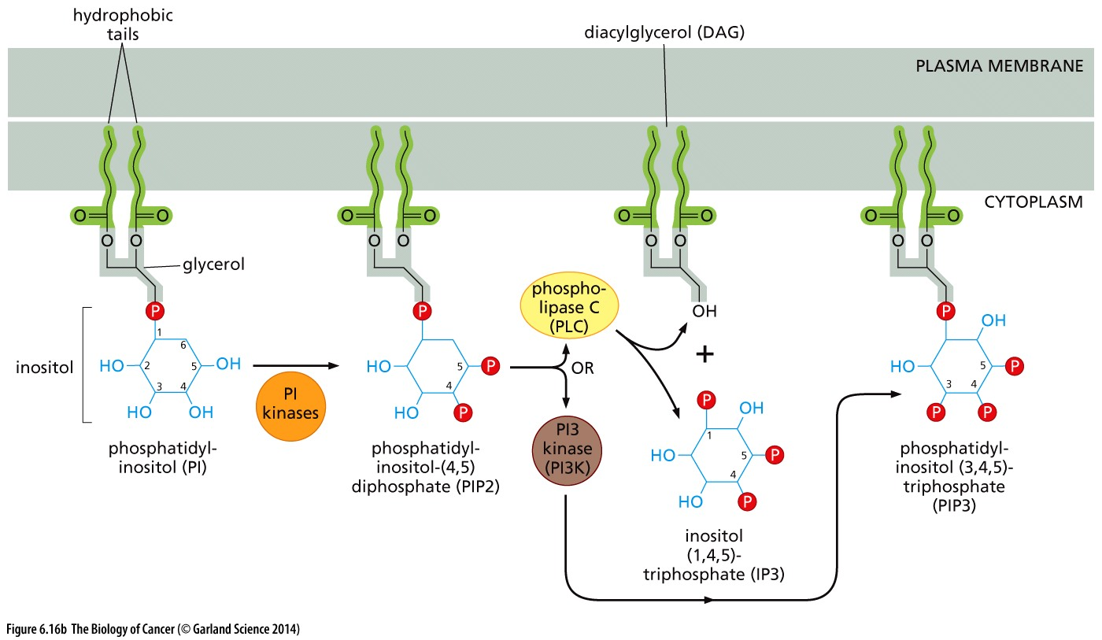
Figure 6.16 Biochemistry of lipid bilayers
--OH
--OH
PTEN
Notes:
教科书上Phosphatidylinositol分子图片有误，少了第六位的-OH， 后面会提到PTEN催化PI3K的逆反应

Slide 37
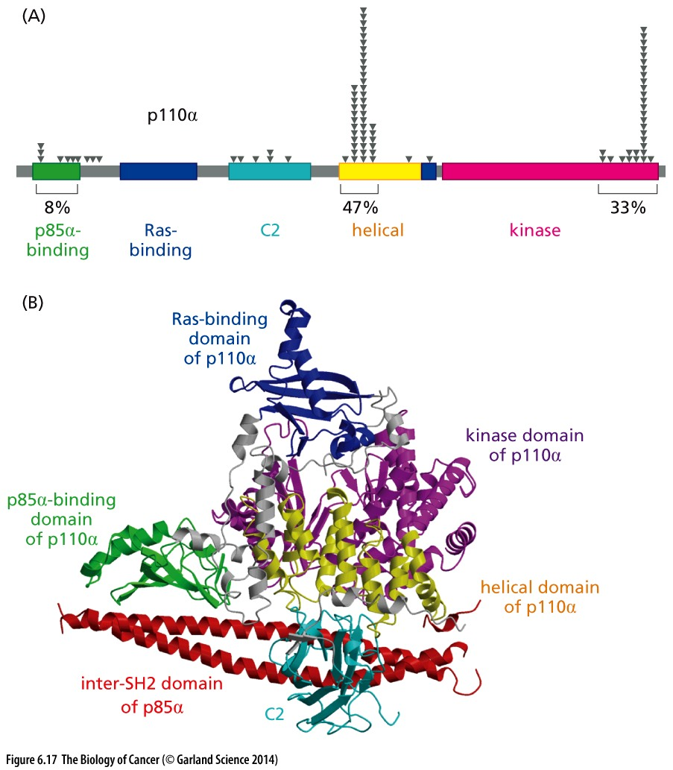
Figure 6.17 Activation of PI3K by Ras, growth factor receptors, and somatic mutation
PI3K is a key enzyme in the control of cell growth and proliferation. The most important form of this enzyme, assembled as a complex of a catalytic subunit, termed p110, and a regulatory subunit, termed p85, is activated by the actions of the Ras oncoprotein and by tyrosine-phosphorylated growth factor receptors (RTKs).
Notes:
从肿瘤genetic alteration角度看，PI3K pathway是最重要的Oncogenic pathway

Slide 38
AKT is the key target of PIP3
The most important PH domain–containing protein is the serine/threonine kinase named Akt, also known as protein kinase B (PKB). (Akt/PKB is yet another protein that was initially discovered because it is encoded by a retrovirus-associated oncogene.) Thus, once PIP3 is formed by PI3K, an Akt/PKB kinase molecule can become tethered via its PH domain to the inositol head group of PIP3 that protrudes from the plasma membrane into the cytosol (Figure 6.19). This association of Akt/PKB with the plasma membrane (together with phosphorylations of Akt/PKB that soon follow) results in the functional activation of Akt/PKB as a kinase.

Slide 39
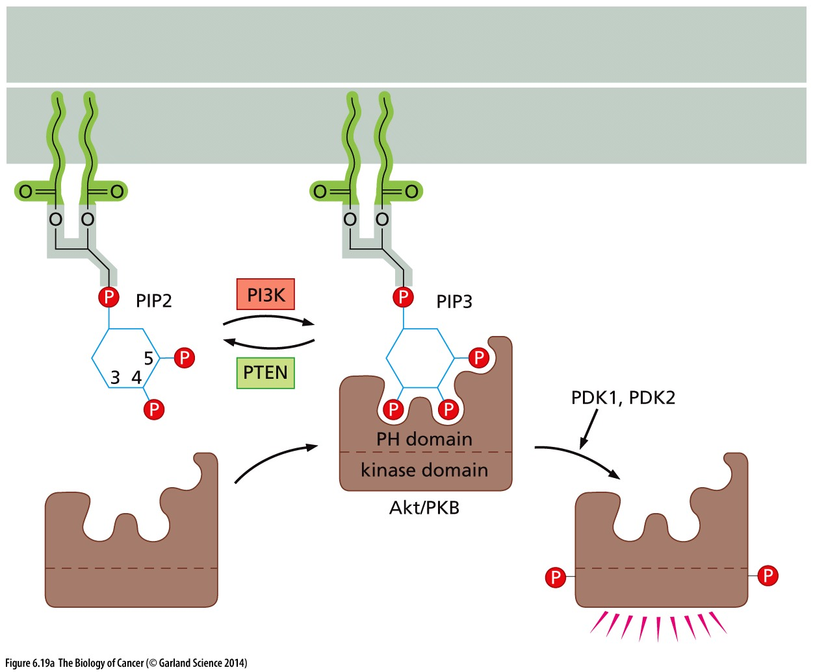
Figure 6.19 Docking of PH domains to PIP3
PTEN, key negative regulator of PI3K pathway
Phosphatase and tensin homolog (PTEN)
AKT is the key target of PIP3

Slide 40
PTEN mutation in human cancer
PTEN is a very important tumor suppressor
www.cbioportal.org
Notes:
检验一个基因在癌症中是否重要的金标准： 该基因在人类癌症中是否存在变异，尤其是genetic alteration. RB， P53, PTEN are currently the top important tumor suppressor.

Slide 41
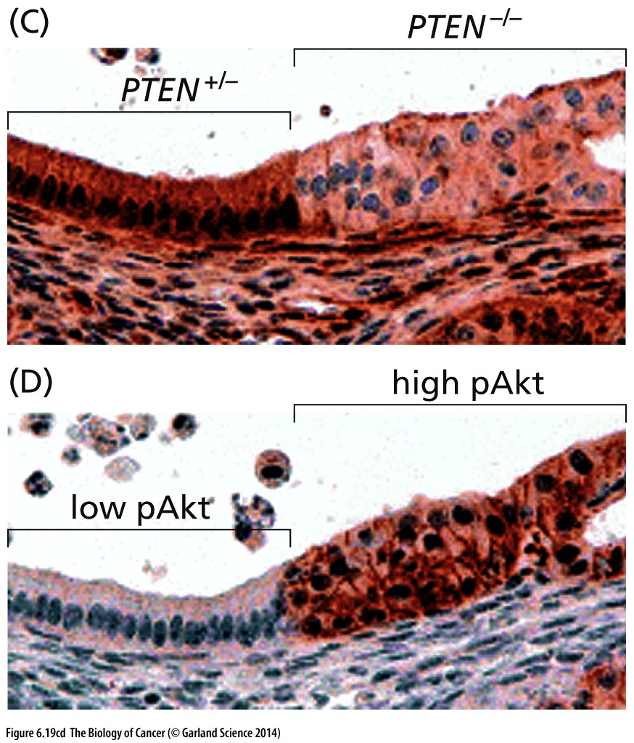
PTEN, key negative regulator of PI3K pathway

Slide 42
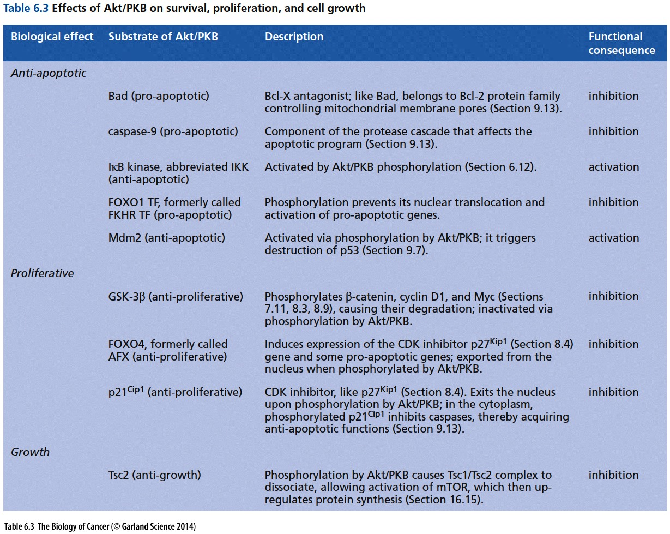
Notes:
具体最下游的分子功能供参考

Slide 43
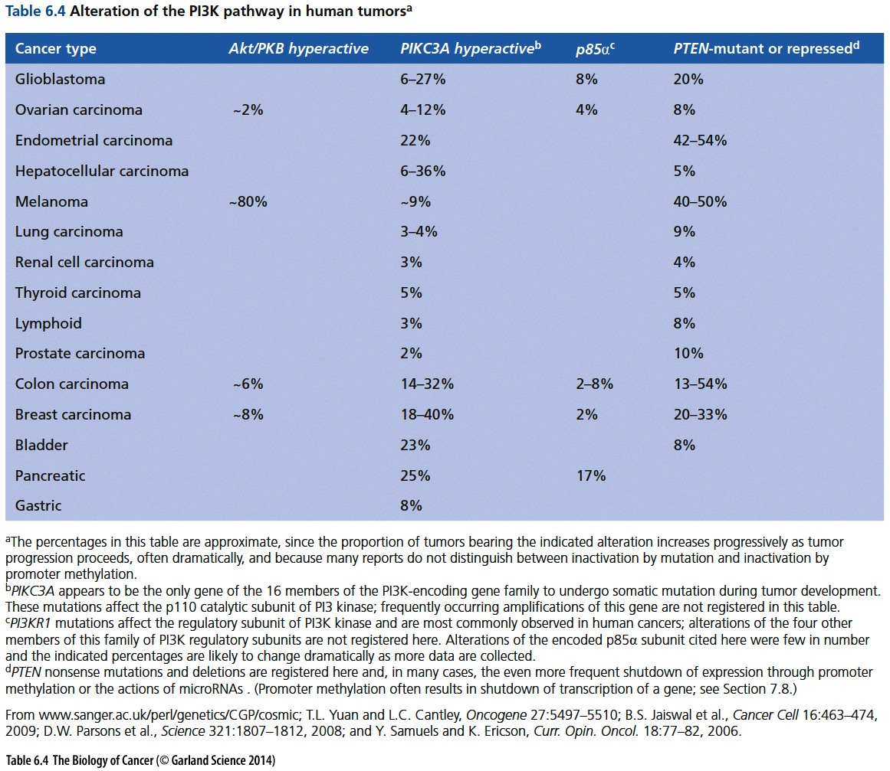
Notes:
实践检验真理，变异检验基因重要性

Slide 44
6.7 Ras-regulated signaling pathways: a third downstream pathway acts through Ral, a distant cousin of Ras

Slide 45
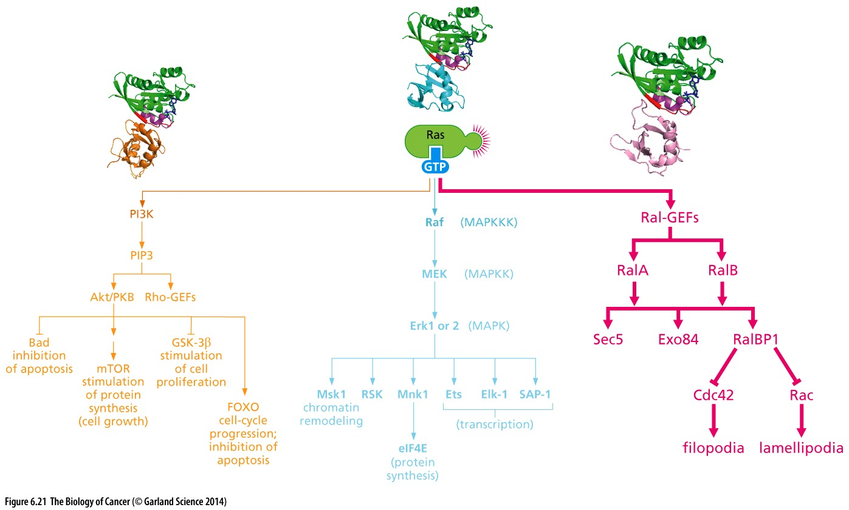
Figure 6.21 Ral and the control of the cytoskeleton

Slide 46
6.8 The Jak–STAT pathway allows signals to be transmitted from the plasma membrane directly to the nucleus
Cytokine receptor signaling: Jak-STAT pathway
Cytokine：growth factors that stimulate components of the hematopoietic system, eg, interferon (IFN), erythropoietin (EPO), and thrombopoietin (TPO)
Jak (Janus kinase)
Notes:
Jak-STAT pathway in blood cancer and others…

Slide 47
Jak–STAT pathway
Following ligand-mediated receptor dimerization, the Jak enzyme associated with phosphorylated tyrosines on the cytoplasmic tails of receptor molecule. The resulting phosphotyrosines attract and are bound by SH2-containing transcription factors termed STATs (signal transducers and activators of transcription), which then become phosphorylated by the Jaks. Consequently, STAT–STAT dimers form, in which each STAT uses its SH2 group to bind to the phosphotyrosine of its partner. The resulting dimerized STATs migrate to the nucleus, where they function as transcription factors (see Figure 6.22).
Notes:
教科书写的详细，总结概括如下…

Slide 48
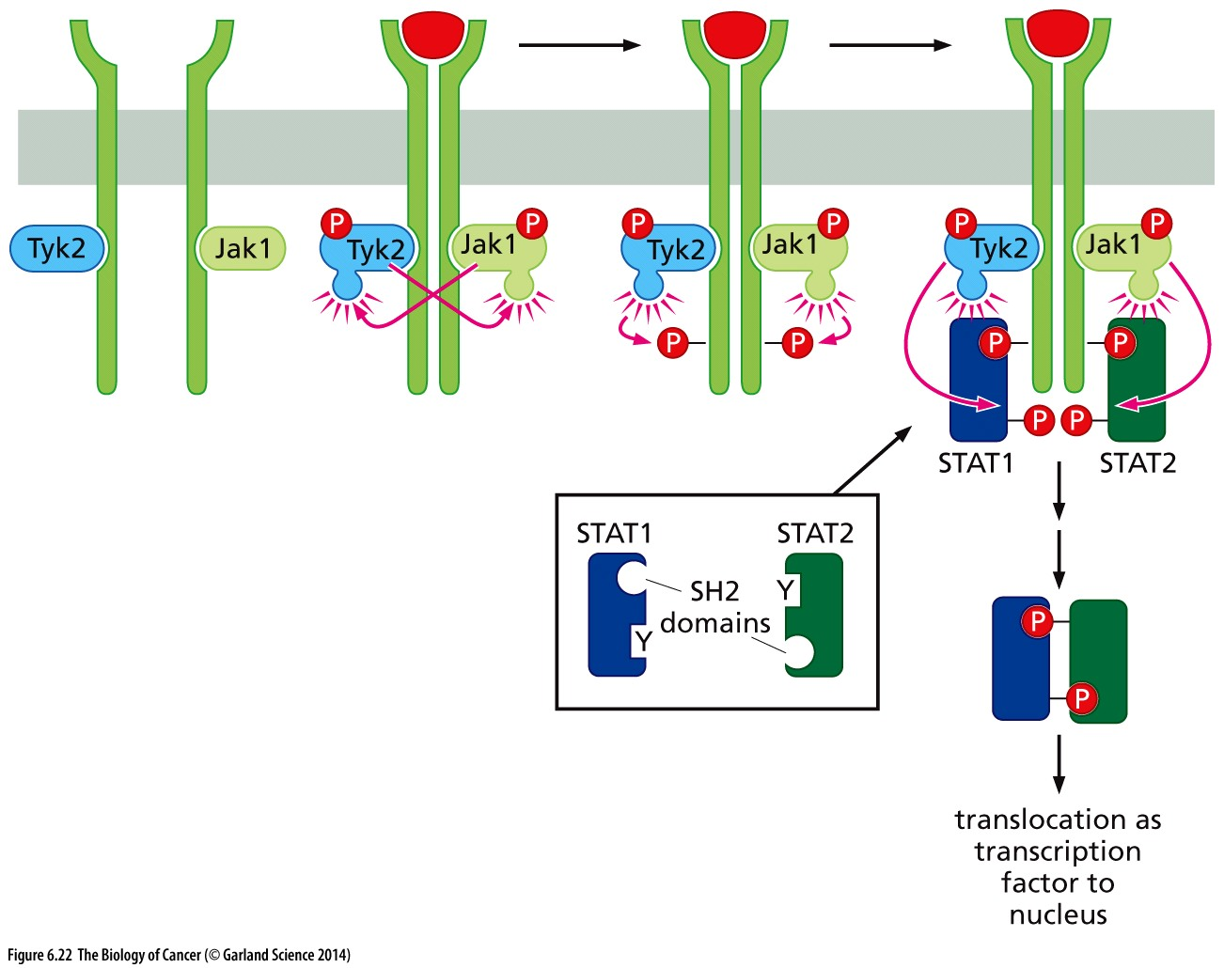
Figure 6.22 The Jak–STAT pathway

Slide 49
6.9 Cell adhesion receptors emit signals that converge with those released by growth factor receptors

Slide 50
Integrins—Mediators of Cell-Matrix and Cell-Cell Adhesion
2022 Albert Lasker Basic Medical Research Award
The 2022 Albert Lasker Basic Medical Research Award honors three scientists for discoveries concerning the integrins, key mediators of cell-matrix and cell-cell adhesion in physiology and disease. Independently, Richard O. Hynes (Massachusetts Institute of Technology) and Erkki Ruoslahti (Sanford Burnham Prebys, La Jolla) identified a cell-surface-associated protein that helps affix cells to the surrounding material, the extracellular matrix (ECM). Then the researchers captured a receptor to which this protein binds. In seemingly unrelated studies, Timothy A. Springer (Boston Children’s Hospital/Harvard Medical School) discovered transmembrane proteins that underlie the ability of immune cells to interact with their targets. These initially disparate lines of inquiry would converge and mushroom after the investigators realized that the proteins—now called integrins—belong to the same molecular family.

Slide 51
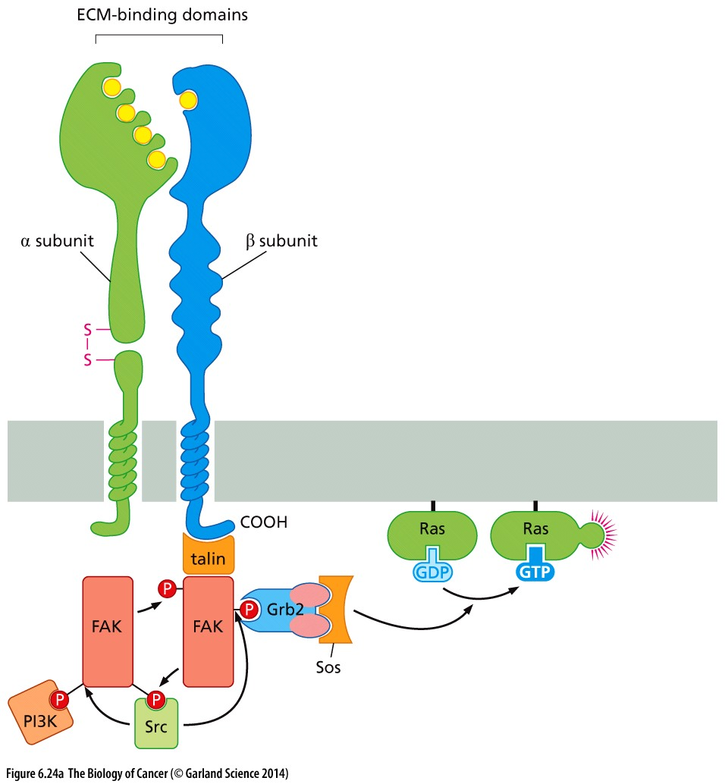
Figure 6.24 Integrin signaling
(A) The integrins are assembled as α + β heterodimers. In addition to physically linking the cytoskeleton to the extracellular matrix, the binding by the ectodomain of the heterodimer to components of the ECM triggers the association of a series of cytoplasmic signal transducing proteins, such as focal adhesion kinase (FAK), with the β subunit. Resulting transphosphorylation events and the attraction of SH2- containing signaling molecules release signals that activate many of the same pathways that are turned on by ligand activated growth factor receptors.
Notes:
细胞接触依赖性生长的部分分子机制

Slide 52
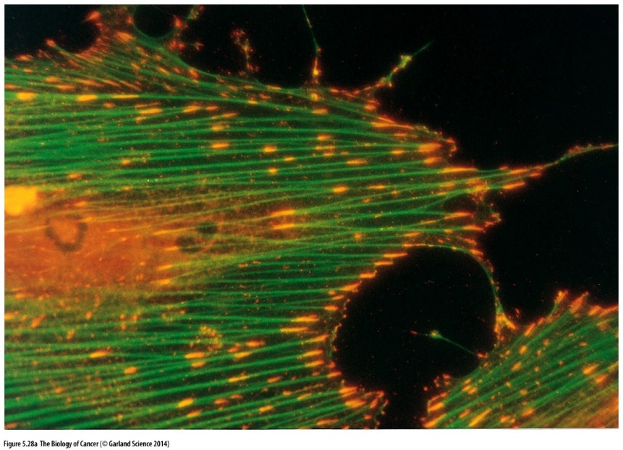
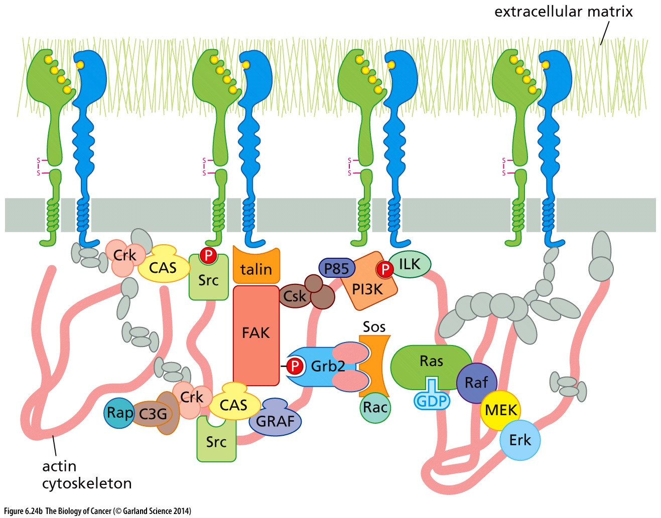
Figure 6.24 Integrin signaling
Focal adhesion (粘着斑)
As indicated here, still poorly understood collection of signal transducing molecules that become physically associated with the cytoplasmic domains of various integrin β subunits following ECM binding. In total, almost 180 distinct proteins have been found to be physically associated with focal adhesions.
Notes:
许多信号分子特异性聚集在focal adhesion(粘着斑) 区域，以应对细胞外环境的变动

Slide 53
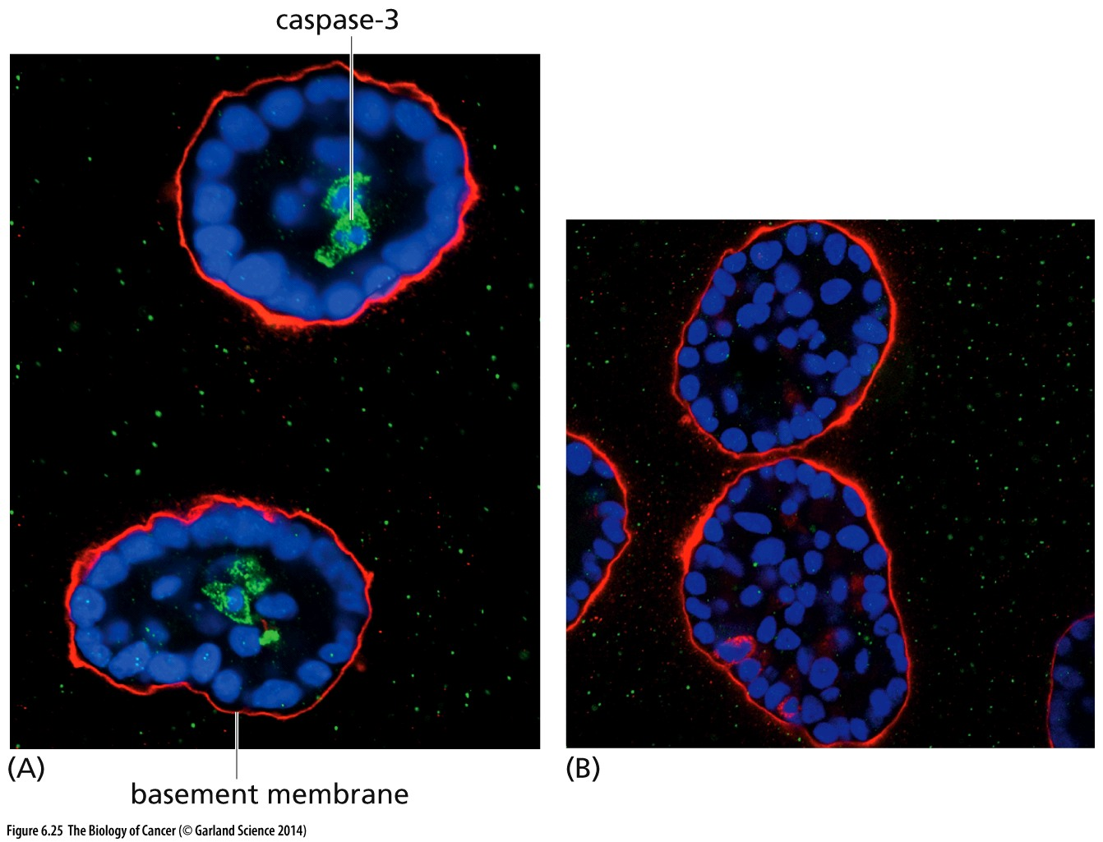
Figure 6.25 Anoikis and morphogenesis
Anoikis(失巢凋亡) serves during morphogenesis to excavate lumina (channels) in the middle of cylindrical aggregates of cells, thereby creating hollow ducts.

Slide 54
6.10 The Wnt–β-catenin pathway contributes to cell proliferation

Slide 55
Figure 6.26 Multiple roles of β-catenin
β-catenin exists in three states:
1, It may be bound to the cytoplasmic domain of cell–cell adhesion receptors, notably E-cadherin (Figure 6.26A); E-cadherin molecules from adjacent cells may associate with one another to form adherens junctions—cell-to-cell contacts that help to ensure the structural integrity of epithelial sheets and impede metastasis (see Section 14.3).
2, in a fully unrelated role, β-catenin exists in a soluble pool in the cytosol, where it turns over very rapidly, having a life time of less than 20 minutes.
3, β-catenin operates in the nucleus as an important component of a transcription factor.

Slide 56
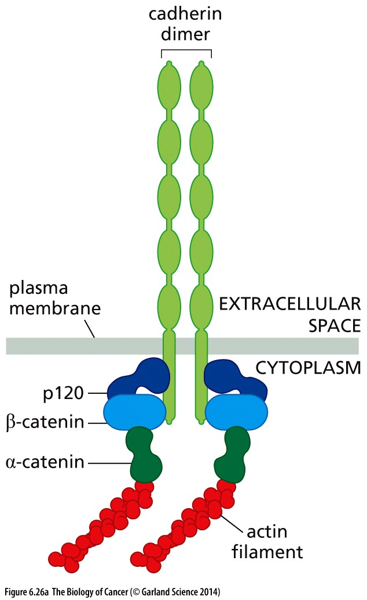
Figure 6.26 Multiple roles of β-catenin
(A) Like many integrins, the cadherins (light green) are transmembrane proteins that form attachments in the extracellular space and become linked, via intermediary proteins, to the actin cytoskeleton (red). The cytoplasmic tail of E-cadherin, for example, is known to associate directly with p120 and β-catenin.

Slide 57
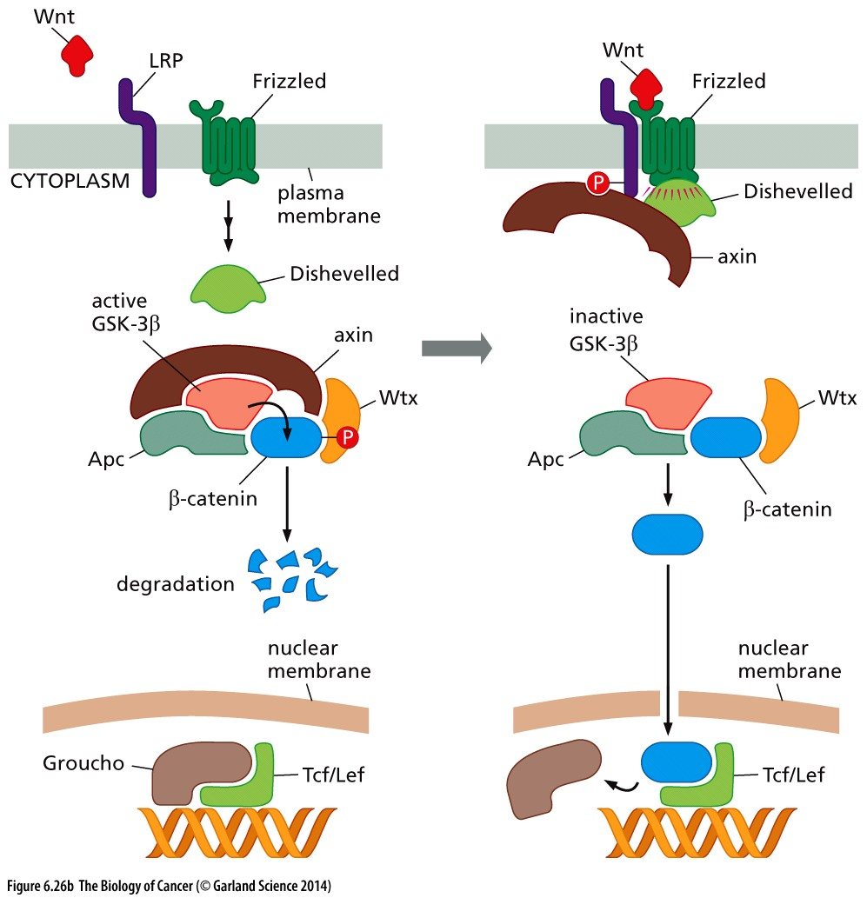
Figure 6.26 Multiple roles of β-catenin
As indicated in Figure 5.23, the Wnt proteins, by binding to their Frizzled receptors and the LRP co-receptor, act via Dishevelled to suppress the activity of glycogen synthase kinase-3β (GSK-3β). This prevents GSK-3β from phosphorylating, among other substrates, β-catenin, which therefore escapes degradation and accumulates in the cytoplasm and in the nucleus. Once in the nucleus, β-catenin associates with Tcf/Lef, transcription factors, displacing the Groucho repressor protein and thereby acting expression of a variety of genes, including those involved in cell proliferation.

Slide 58
Wnt-β-catenin signaling in human cancer
1, APC mutation in most colorectal cancer(结直肠癌)
Adenomatous polyposis coli (APC)
APC mutation frequency
Most APC mutation are loss of function mutation
Colorectal (TCGA)
Colorectal (MSKCC)
Colorectal (TCGA pub)
www.cbioportal.org

Slide 59
2, β-catenin mutation in liver, uterine(子宫) cancer
CTNNB1 mutation frequency
Most CTNNB1 mutation are activation mutation
Uterine (TCGA)
Liver (TCGA)
Liver (Inserm 2014)
Uterine (TCGA pub)

Slide 60
6.11 G-protein–coupled receptors can also drive normal and neoplastic proliferation
G-protein–coupled receptors (GPCRs) are transmembrane proteins that weave their way back and forth through the plasma membrane seven times. Upon binding their extracellular ligands, each of these “serpentine” receptors activates one or more types of cytoplasmic heterotrimeric G-protein, so named because of its three distinct subunits (Gα, Gβ, and Gγ), the first of which binds either GDP or GTP.
Notes:
本校iHuman 研究所专注于研究GPCR, GPCR只是与少量特定类型肿瘤相关

Slide 61
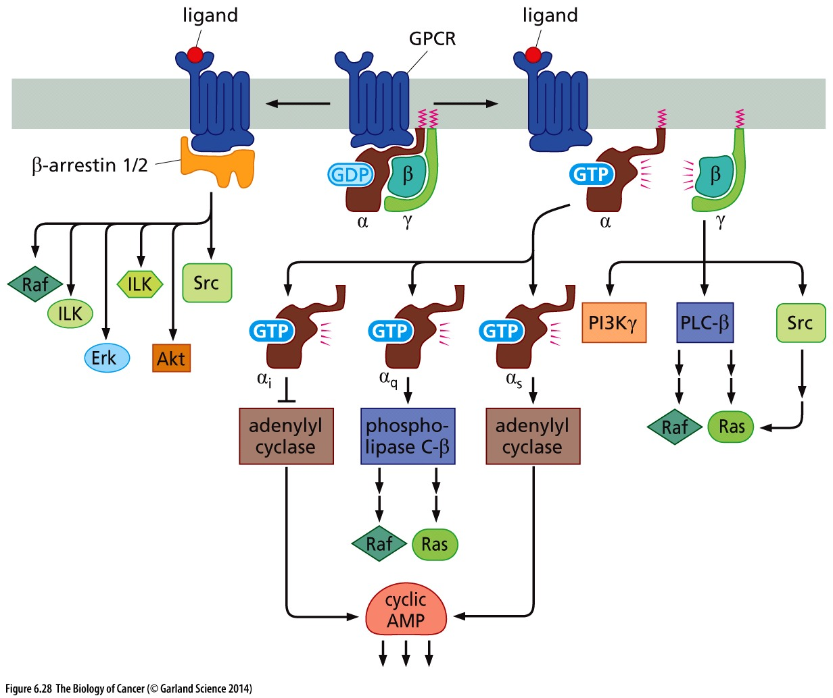
Figure 6.28 G-protein–coupled receptors
The seven-membrane spanning receptors are able to activate a variety of heterotrimeric G proteins that differ largely in the identity of their Gα subunits. Once stimulated by a GPCR, the Gα subunit separates from Gβ and Gγ and proceeds to activate or inhibit a variety of cytoplasmic enzymes, only two of which (adenylyl cyclase and phospholipase C-β) are shown here. These enzymes, in turn, can have mitogenic or anti-mitogenic influences, depending upon the cell type.

Slide 62
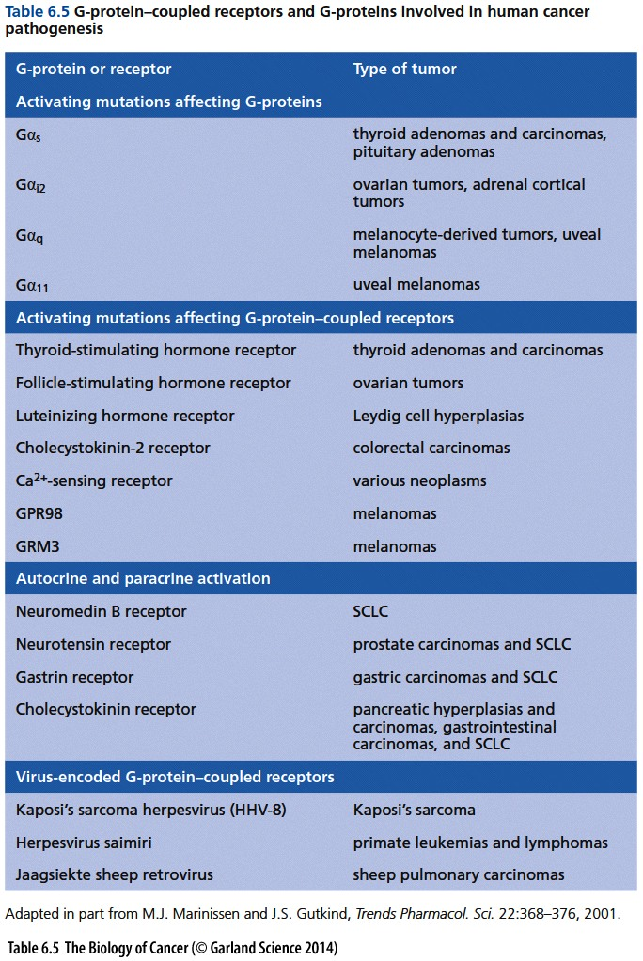
Notes:
仅供参考, GPCR只是与少量特定类型肿瘤相关

Slide 63
“dual-address” signaling pathways
Both Jak–STAT and Wnt–β-catenin signaling represent “dual-address” pathways, which operate by modifying and dispatching to the nucleus proteins that normally reside in the cytoplasm; once in the nucleus, key proteins in these two pathways (that is, STATs and β-catenin) function as components of specific transcription factors to drive gene expression.
Cell signaling regulation: modification; localization, concentration

Slide 64
6.12 Four additional “dual-address” signaling pathways contribute in various ways to normal and neoplastic proliferation

Slide 65
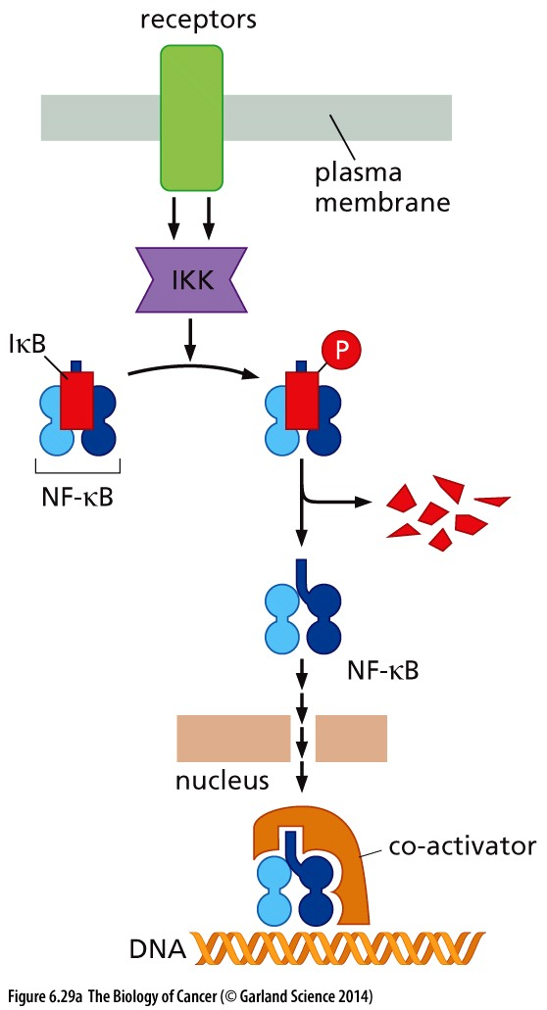
NF-κB pathway
The NF-κB family of transcription factors, which function as heterodimers, are sequestered in the cytoplasm by IκB. A variety of receptors and afferent signals activate IKK, which phosphorylates IκB, tagging it for proteolytic degradation. Now liberated from IκB, NF-κB can translocate to the nucleus, where it activates a broad constituency of genes, including anti-apoptotic and mitogenic genes.
NF-κB protein can be strong oncogene, eg. rel oncogene

Slide 66
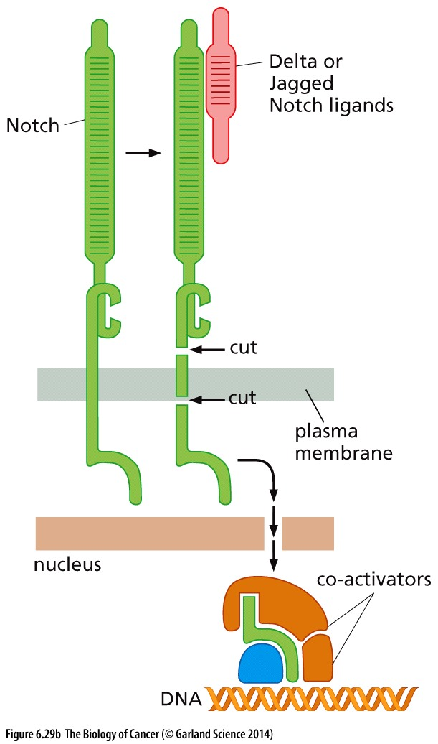
Notch pathway
The Notch receptor can bind ligands belonging to the Delta-like and Jagged families. Ligand binding causes two proteolytic cuts in Notch, liberating a cytoplasmic fragment that can translocate to the nucleus, where it functions as part of a transcription factor complex. The Notch ligand and the ectodomain of the receptor are then internalized and then degraded by the ligand-presenting cell (see Figure 5.21).

Slide 67
Context dependent function of Notch pathway in cancer
In about 60% of T-cell acute lymphocytic leukemias (T-ALLs), mutated and constitutively active forms of Notch are found. This implicates an oncogenic function of Notch.
In some carcinomas Notch tend to function as tumor suppressors. Hence, the contributions of Notch signaling to cancer development seem to be highly dependent on cellular context.

Slide 68
Hedgehog pathway
(C) In this simplified depiction of Patched (Ptc)-Smoothened signaling, the binding of a Hedgehog (Hh) ligand releases Smo from Ptc control. Smo then allows Gli to escape degradation and accumulate in the nucleus, where it functions as a transcriptional inducer.

Slide 69
TGF-β pathway
(D) Binding of the TGF-β ligand to the type II TGF-β receptor brings the type II and type I receptors together and results in the phosphorylation of the type I receptor. The latter, now activated, phosphorylates cytosolic Smad2 and/or Smad3 proteins; these phospho-Smads then bind to Smad4. The resulting heterotrimeric Smad complexes translocate to the nucleus, where they bind DNA, induce or repress gene expression.

Slide 70
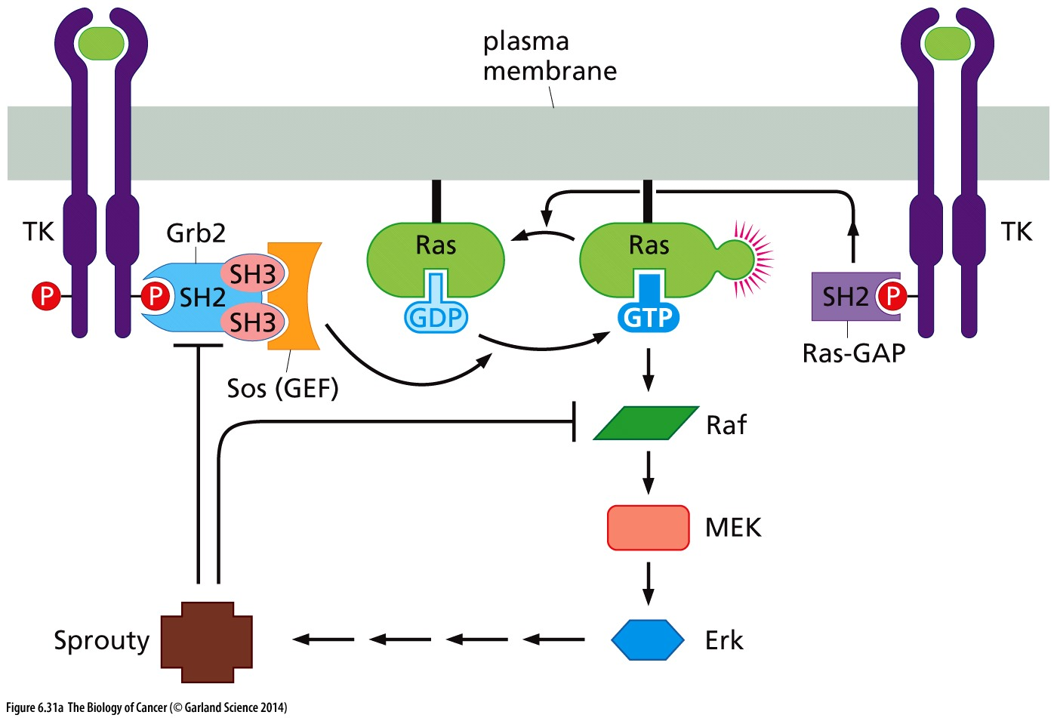
Figure 6.31 Negative and positive feedback controls of signaling
(A) When GF receptors bind ligand, the resulting activation of the Ras → Raf → MEK → Erk signaling pathway causes Sprouty to block binding of Grb2 to Sos, thereby shutting down further Ras activation. Functioning in parallel to this negative-feedback loop, the binding of Ras-GAP via its SH2 group to a phosphotyrosine on the cytoplasmic tail of a ligand-activated receptor places it in a position where it can shut down further Ras signaling by inducing GTP hydrolysis by Ras.

Slide 71
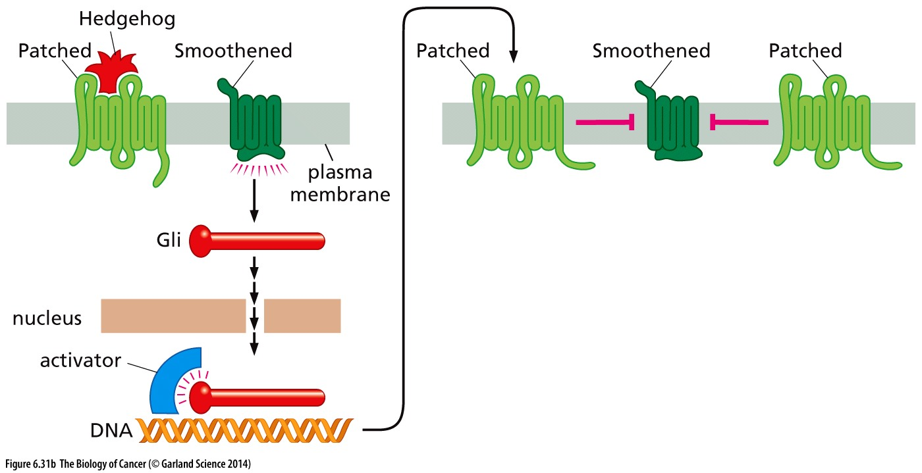
Figure 6.31 Negative and positive feedback controls of signaling
(B) Binding of Hedgehog to Patched permits signaling by Smoothened, one of the consequences of which is the activation, via Gli, of Patched transcription. The increased numbers of Patched molecules then function to inhibit further signaling by Smoothened.
Notes:
另一个例子，供参考

Slide 72
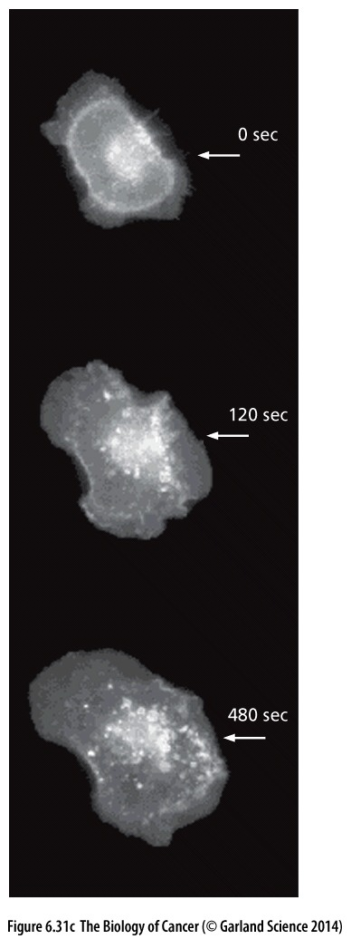
Receptor internalization after stimulation
(C) An important mechanism of shutting down RTK signaling involves the physical internalization of receptor molecules, preventing them from binding ligand in the extracellular space. When a cell is exposed to epidermal growth factor (EGF), introduced into the medium at the location shown (arrowheads), the EGF initially causes the cell surface EGF receptor molecules, which in this case have been linked to a fluorescent dye, to release mitogenic signals into the cell. However, within 120 seconds, the fluorescing EGF-R molecules have been internalized on the side of the cell facing the EGF source; and by 480 seconds, they are found in internalized clusters on all sides of the cell.
Notes:
负调节RTK通路的重要机制

Slide 73
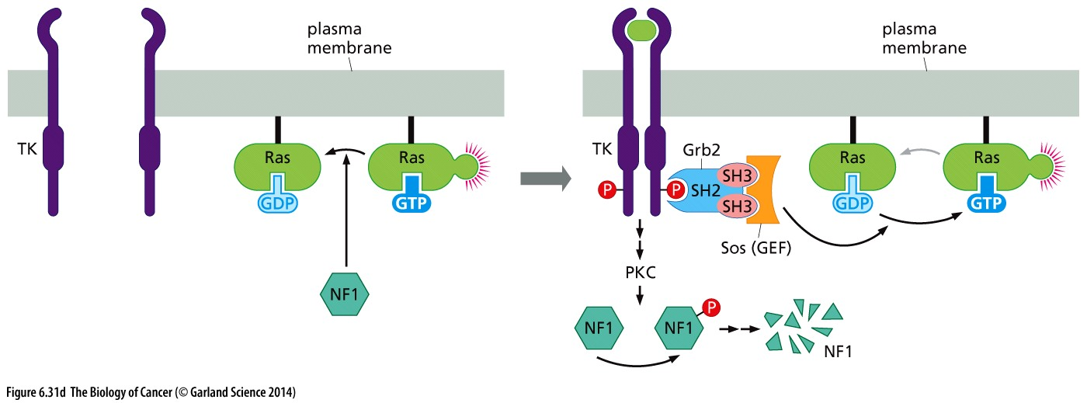
Positive feedback through NF1
(D) A positive feedback mechanism is illustrated by the actions of NF1 (neurofibromin), which in resting cells ensures the hydrolysis of Ras-bound GTP and associated inactivation of signaling by Ras. However, when a GF-activated receptor begins to release signals, it activates a form of PKC (protein kinase C) that phosphorylates NF1, causing its ubiquitylation and degradation, thereby enabling a rapid increase in firing by active, GTP-bound Ras molecules (right).
Notes:
Neurofibromin is a GTPase-activating protein (GAP) that negatively regulates Ras pathway activity by accelerating hydrolysis of Ras-bound guanosine triphosphate (GTP)

Slide 74
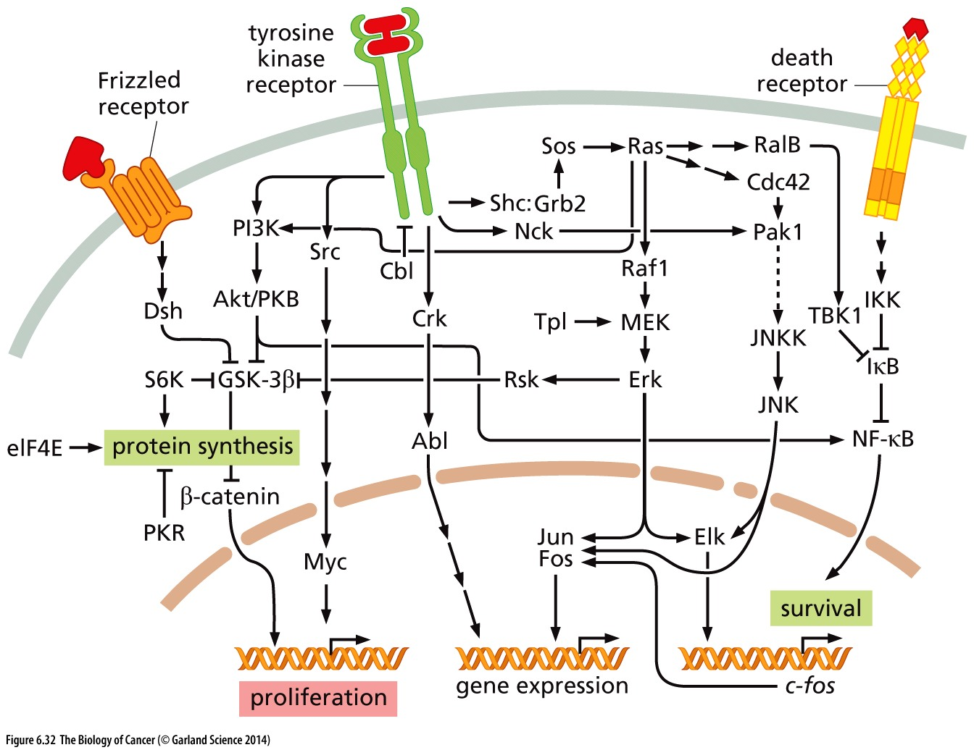
Figure 6.32 Two-dimensional signaling maps
While we have depicted signaling pathways as linear cascades reaching from the plasma membrane to the nucleus, with occasional branch points, a rapidly growing body of research reveals that these pathways interact via numerous lateral cross connections and points of convergence. This diagram, itself a simplification, provides some hints of these cross connections. Note, for example, that GSK-3β, which plays a central role in the Wnt–β-catenin pathway, is also regulated by signaling proteins lying downstream of tyrosine kinase receptors.
Notes:
具体内容仅供参考

Slide 75
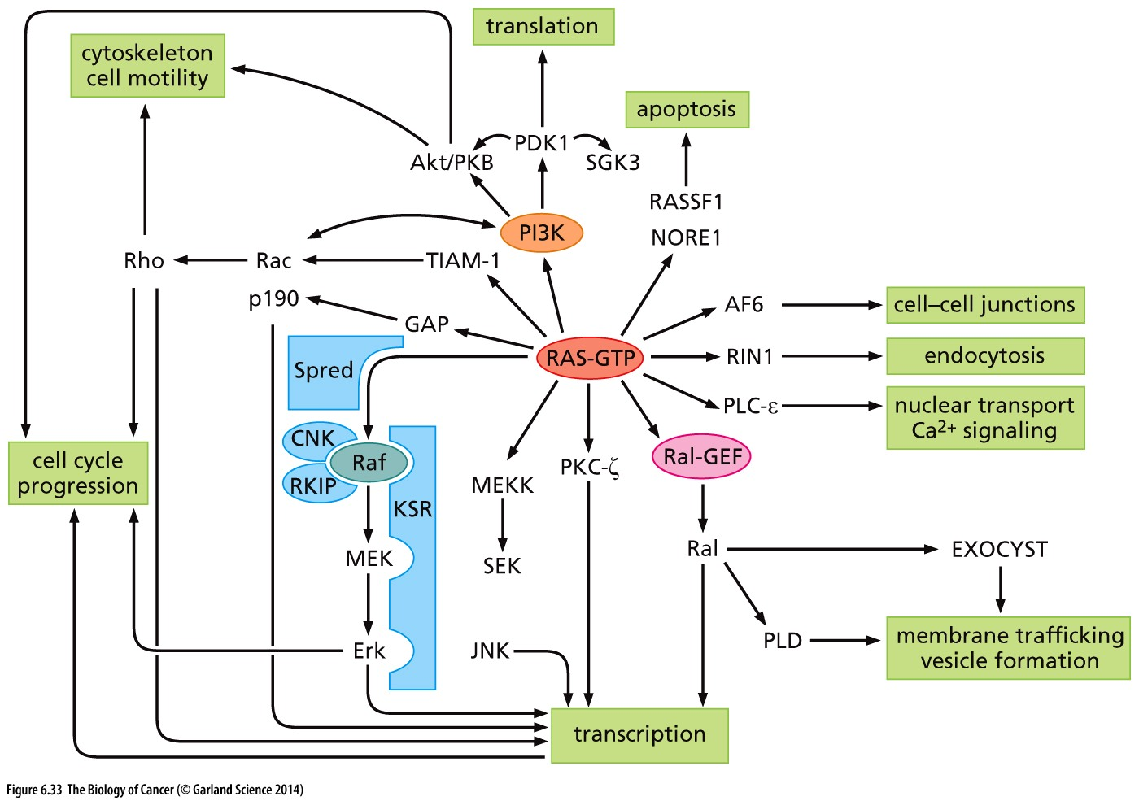
Figure 6.33 Ras effector pathways
Detailed biochemical analyses of the GTP-bound, activated form of the Ras proteins indicate that these proteins bind to far more than the three major effectors of Ras signaling—Raf, Ral-GEF, and PI3 kinase (PI3K). As shown here, at least eight additional Ras-interacting proteins have been uncovered, most of which are known or suspected to play key roles in relaying Ras signals to specialized downstream signaling circuits involved in functions as diverse as transcription, membrane trafficking, endocytosis, and translation.
Notes:
具体内容仅供参考

Slide 76
Complexity of Cancer Signaling Transduction
1, Components of signaling are often encoded by family of genes; multiple modifications exist, signaling crosstalk, feedback…
2, Different types of cancer cells use different signaling pathway to become transformed;
3, In the same pathway, some genes but not others are highly selected to be genetically altered in cancer;

